Slide 6
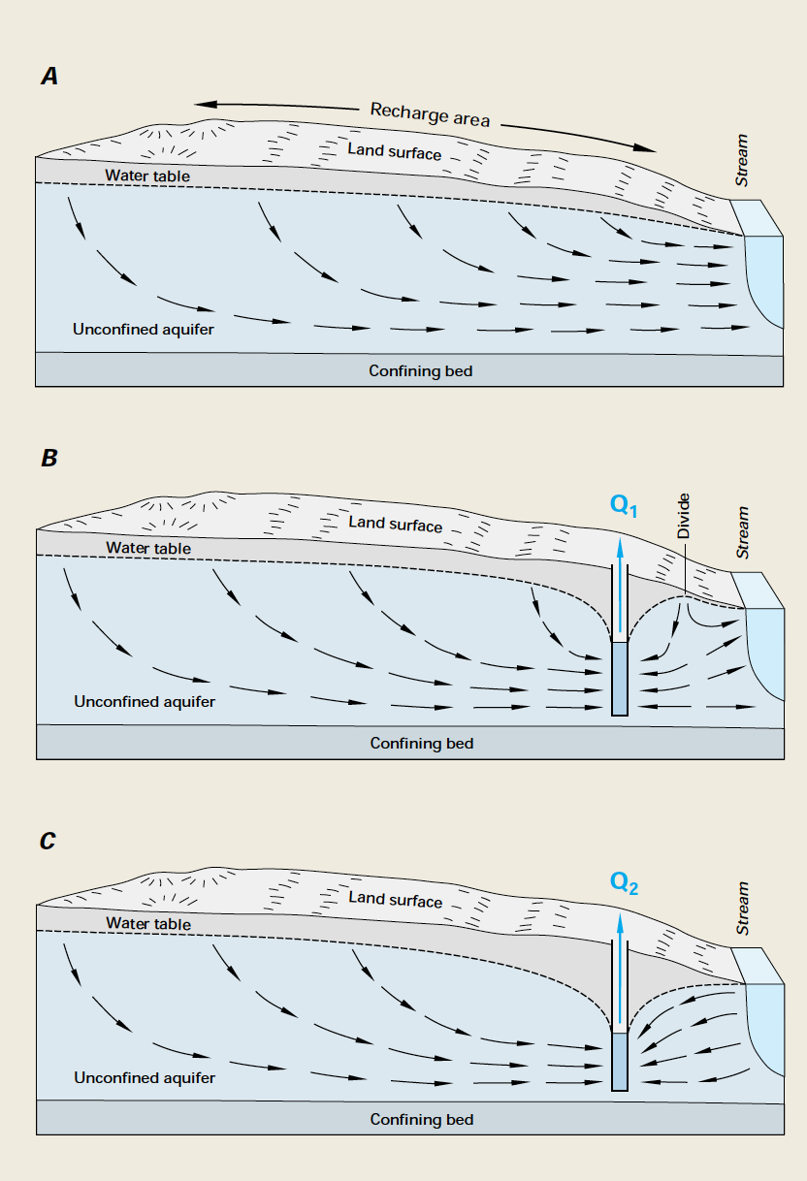
Gravelly Pond – Natural Condition
Current Operation
Round Pond well pumped into Gravelly Pond
Alternative Operation
Pump direct from Round Pond well (induced infiltration from Gravelly Pond)

Slide 7



